Slide 1
The best time to clean the station
Mohammed Alhamoud

Slide 2
Outline:
-Introduction
-Data
-Analytical approach
-Conclusion

Slide 3
Introduction:
The idea is to find the busiest station. And try to look for the best time during day to do cleaning
Question:
What is the best time to do cleaning during the weekdays?
What is the best time to do cleaning during the weekends?

Slide 4
Data:
The data set in MTA that will use from July 2021 - Sep 2021.

Slide 5
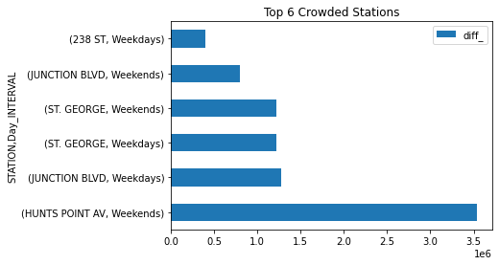
Analytical approach:

Slide 6
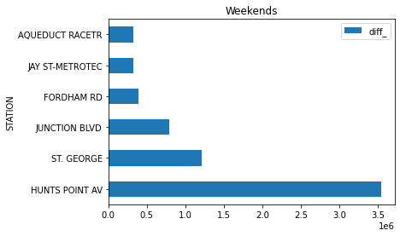
Top 6 station crowded on Weekends:

Slide 7
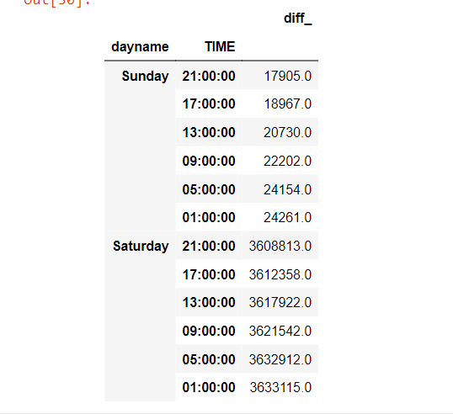
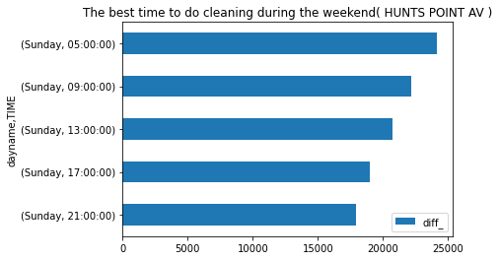
The best time to do cleaning during the weekends( HUNTS POINT AV ):

Slide 8
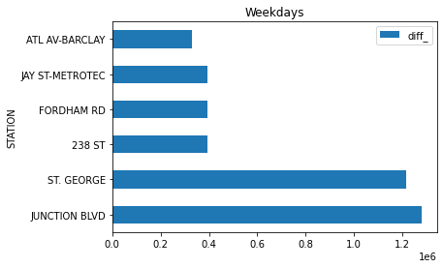
Top 6 station crowded on Weekdays:

Slide 9
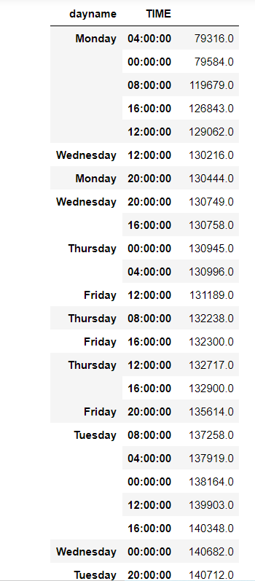
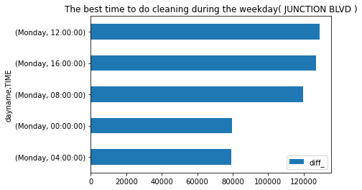
The best time to do cleaning during the weekdays( JUNCTION BLVD ):

Slide 10
Conclusion:
It is necessary to target the station on the day and time the least crowded during weekdays and weekends and make it the time to cleaning up the station.
After work, we reached the right time to cleaning the station on weekdays ( JUNCTION BLVD ) is Day: Monday and time 4:00.
And the right time to clean the station on weekends ( HUNTS POINT AV ) is Day:Sunday and time 21:00.

